Slide 1

Discover Ability Network
2022

Slide 2
Let’s talk about…
What is Discover Ability?
Lumina Personality Assessment
Questions

Slide 3
Ontario Chamber of Commerce
150
Local Chambers of Commerce
60,000
Members across Ontario
  75% of Ontario businesses reported # 1 barrier issue is finding talent (OCC, 2019)
  Skills shortages are limiting business growth, development and innovation
  People with disabilities represent an untapped talent pool that can help fuel innovative growth and a measured return on investment

Slide 4



What is the Discover Ability Network? www.discoverability.network
Job matching platform
connects job seekers with disabilities to businesses who wish to hire diverse candidates.
Free training
on disability, disclosure, accommodations, telling your job search story, job search, mentors, in the workplace.
Networking
events that connect employers to job seekers, to build disability confidence.
7

Slide 5

The Benefits of Joining
Job matches based on fit and preference
The system ‘job searches’ for you
Access to job boards
Targeted messages about your community
Exposure to jobs you may not have thought of

Slide 6
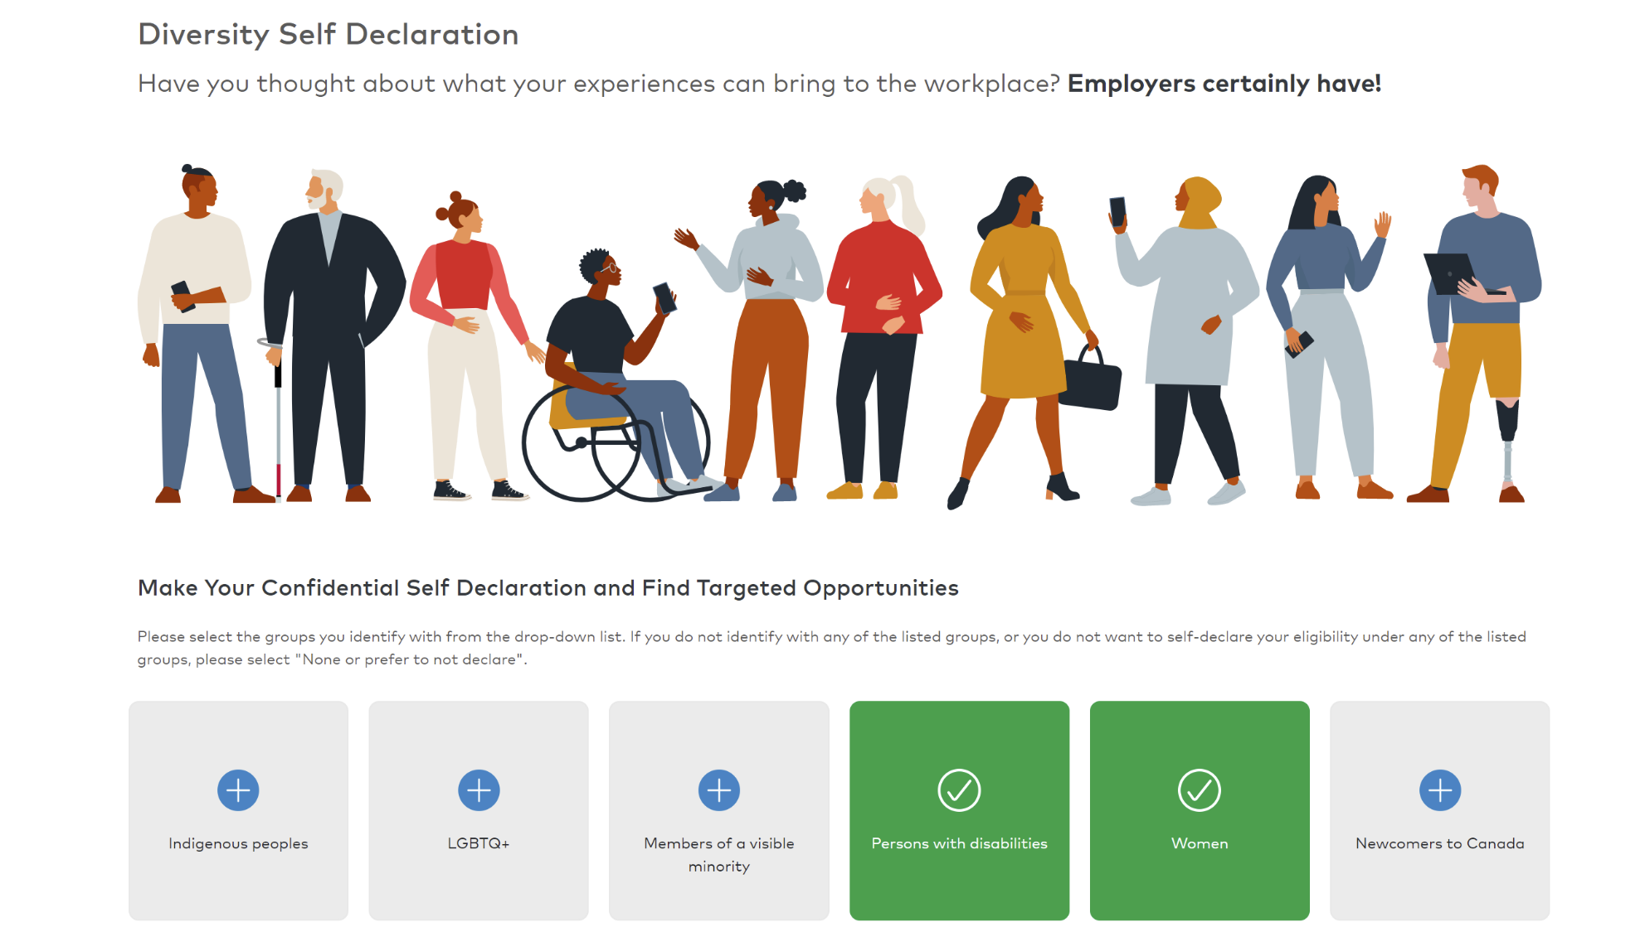
Diversity Self Declaration – your information is protected. It will only be used to match you to employers using the targeted diversity filter.
Notes:
You can confidentially self-declare with any of the groups you self-identify with. No one will see this information, it is only used to push you content on topics that may interest you based on your disability.

Slide 7
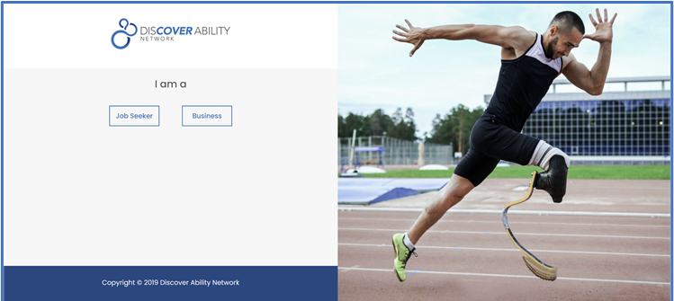
Sign in
www.discoverability.network
Notes:
The Discover Ability Network landing page has you sign in as a job seeker or a business. Select the job seeker button.

Slide 8
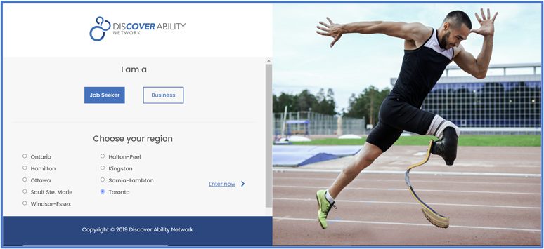
Choose a region
Notes:
You will now be asked to choose a region. Discover Ability has hubs in Hamilton, Ottawa, Sault Ste Marie, Windsor-Essex, Halton Peel, Kingston, Sarnia Lambton and Toronto. If you live in one of these regions, select the city or area so that you can receive customized jobs and job search information. You can still apply to jobs outside of your region.
If you do not live in one of these regions select the Ontario option. Once you select a region the words enter now appear. Select this button.

Slide 9
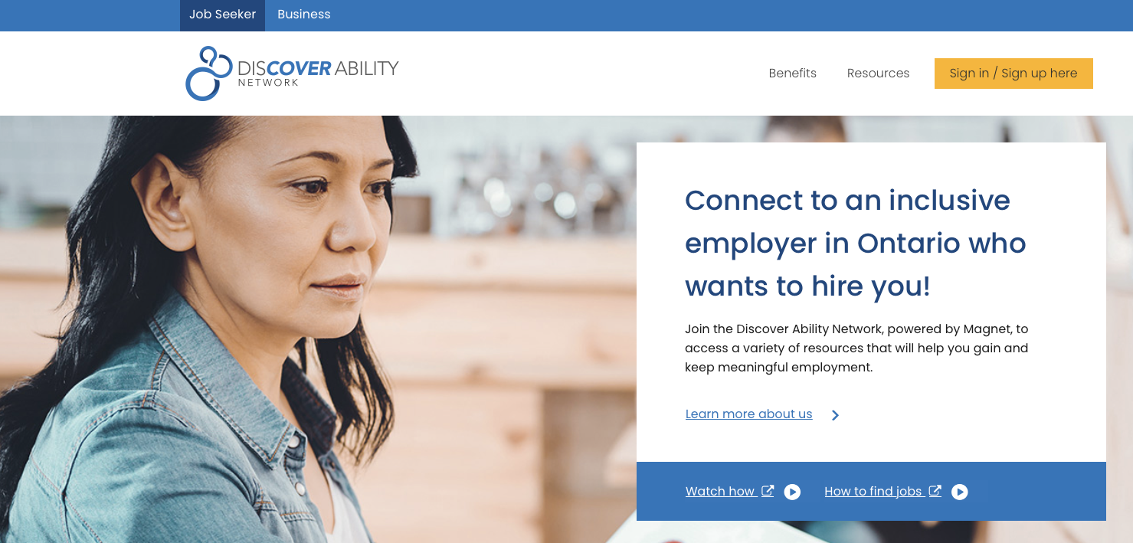

“Sign up / Sign in” or the large box
Select the bright yellow button or the large centre right hand box to sign in, sign up or to access your profile and job search
Notes:
Step 3 is to select the yellow find job opportunities button in the top right-hand corner of the job seeker page.

Slide 10

A fit-based approach to job search
Developed by OTEC and powered by Magnet, Lumina is a unique way of creating matches between job seekers and employers who are looking for talent.
We all have aptitudes and personality traits that will make us more successful in some roles than others.
Lumina helps you figure out your best fit for the job.

Slide 11
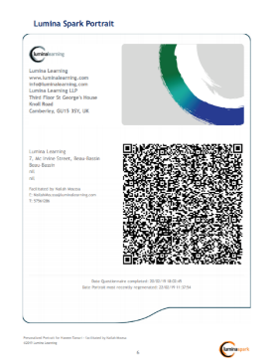
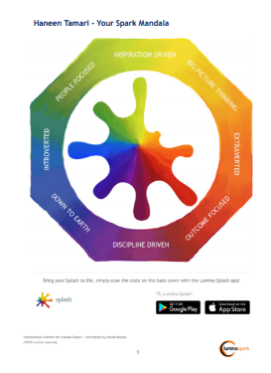
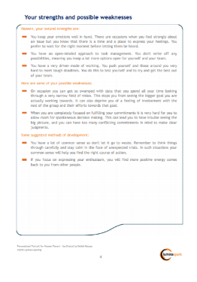
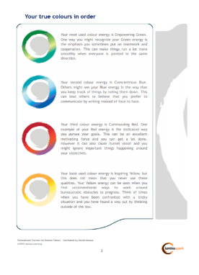

Lumina Personality Profile Sample Report
*Some pages wIll be displayed in the language you chose to do the survey in
Notes:
Page 3 & 4 are language aware
Page 5: Spark Mandala

Slide 12
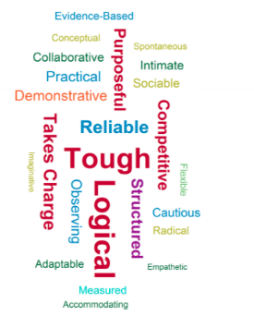
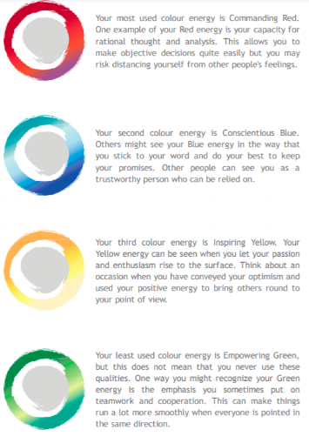
Transferrable skills
The Lumina tool can help you find ideas for your resume and online profiles

Slide 13





Learn more
Visit https://discoverability.network/ for more information. For assistance with signing up, please contact Elizabeth Novak at elizabethnovak@occ.ca or Boyan Mitrovic at BoyanMitrovic@occ.ca for more information.
Twitter @HireAbilityNow
Facebook @HireAbilityNow
LinkedIn www.linkedin.com/company/discover-ability-network/
YouTube www.youtube.com/channel/UCPIcAXSR6QffYKyV4kZEVhA
All information in this document is protected under the copyright laws of Canada and/or other countries. Users of this document may not redistribute, reproduce or republish any such information in any manner, without the prior written consent of the Ontario Chamber of Commerce.

