Slide 1





CAREER PREPARATION SYMPOSIUM
PREPARING TO TRAILBLAZE:
A DISABILITY POSITIVE CAREER JOURNEY
March 12, 2024

Slide 2

LAND ACKNOWLEDGEMENT

Slide 3

ASL INTERPRETERS
American Sign Language Interpreters, Ryan and Melissa, will be providing interpretation for today’s event.
Each speaker and ASL interpreter will be automatically spotlighted on the screen.

Slide 4
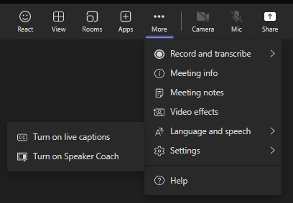
CAPTIONING
To turn on Auto-Captioning:
“More”
“Language and speech”
“Turn on live captions”
1
2
3

Slide 5

ENGAGEMENT GUIDELINES
Comments and technical questions can be typed in the Chat
After the break there will be a Q&A session
Questions for the speakers should be made in the Q+A box. We will do our best to answer as many as time allows. Please keep your questions brief.
Please keep your questions and comments polite and respectful – remember intention versus impact of your statements.

Slide 6
AGENDA
TIME | ACTIVITY
9:00 am | Welcome, land acknowledgement, overview of the day, guided meditation
9:10 am – 9:45 am | Keynote Presentation by Tim Rose — Preparing to Trailblaze: A Disability Positive Career Journey
9:45 am – 9:55 am | Break
9:55 am | Reminders and prize draw announcement
10:00 am | Q&As
10:25 am | Wrap up
10:30 am | Adjourn

Slide 7

GUIDED MEDITATION

Slide 8
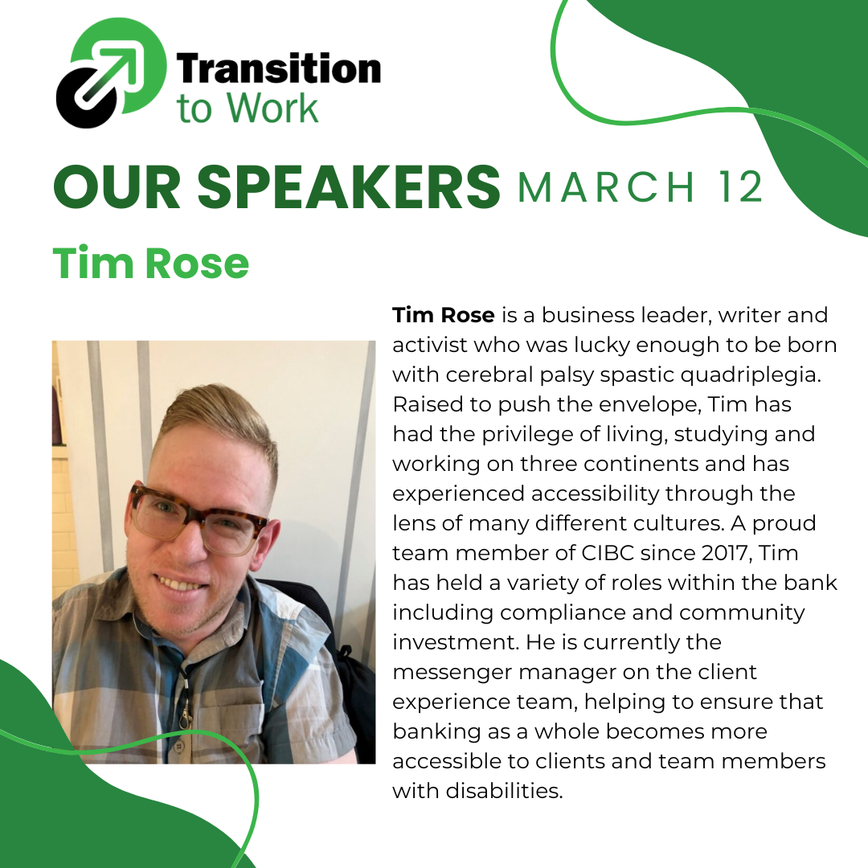

Slide 9
Preparing to Trailblaze:
A Disability Positive Career Journey
Speech outline:
I was lucky enough to be born with a superpower. Other people call it a disability
My early years and ‘disability positive’ parenting
The importance of education, forging your own path
Career struggles…they happen to everyone
Reframing my disability as a career benefit
Don’t accommodate difference, celebrate difference
My journey into the corporate world
Lessons I have learned throughout my career and how to ‘flip the script’
What it means to be a trail blazer, to use your superpower
Wrap up
Thank you

Slide 10
BREAK
Coming up after the break—
  Prize draw winner!
  Questions and Answers with Tim Rose. (Post your questions in the Q&A option in Teams)
  Wrap up at 10:30 am

Slide 11


PRIZE DRAW!
The winner will receive their prize by email within one week.
Questions? Contact Careers@Humber.ca

Slide 12

QUESTIONS
Use the Q&A function to ask questions

Slide 13

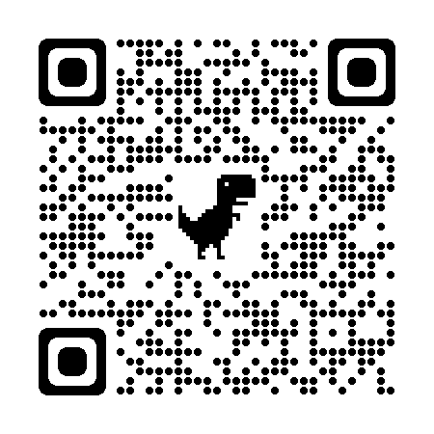
C0-CURRICULAR RECORD
Students from Humber or Guelph Humber attending the live symposium, to the end, can add to their Co-Curricular Record.
Once the event is over, log onto the CCR portal with your MyHumber credentials, search for today’s event, and add the experience to your record
CCR Portal: https://www.humber.ca/student-life/ccr/
Event Name:
Transition to Work – Career Preparation Panel Discussion March 2024
To learn more, check out this tutorial: https://youtu.be/_08SM1Z5j6k
Questions? Please email CCR@humber.ca

Slide 14

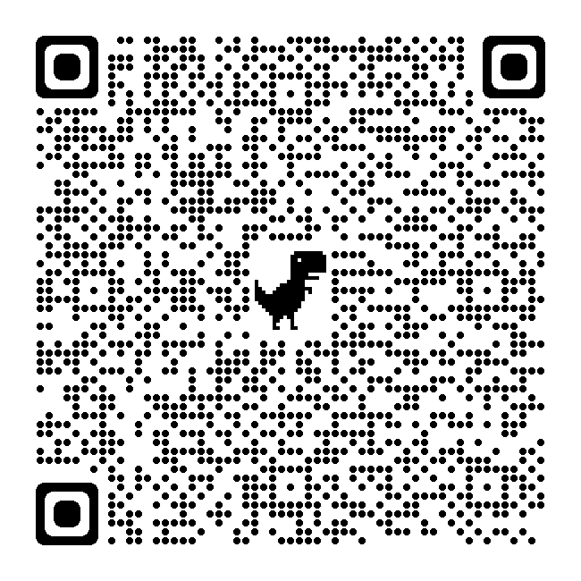
FEEDBACK
We want to hear your feedback and suggestions. The symposium survey will be open until March 26th.
If you are attending the panel discussion, please wait until tomorrow to do the survey.
There are 3 ways to access the survey:
  Click the link in the Teams chat, OR
  Check your email for the link, OR
  Scan this QR code

Slide 15


THANK YOU!

Slide 16
RESOURCES
Transition to Work
https://careers.humber.ca/transition-to-work.php
Humber Career Services
https://careers.humber.ca/index.php
Guelph-Humber Career Services
https://www.guelphhumber.ca/career/contact
Co-Curricular Record (Humber & Guelph-Humber)
https://www.humber.ca/student-life/ccr/
Seneca Works
https://sw.senecapolytechnic.ca/home.htm

Slide 17

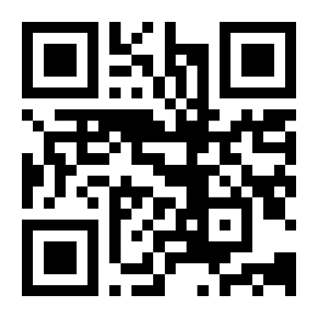
Humber College
Accessible Learning Services – Supports for current students with disabilities including academic accommodations, assistive technology training and disability-related funding.
Career & Student Success Advisors - Help to guide your academic and career journey and connect you to on-campus resources and support services.
Career Support Peers - One on one appointments for current students for general career development support such as resume review, cover letter review, LinkedIn profile, and mock interviews.
Career Connect - Job portal for full-time, part-time, contract, summer, volunteer and on-campus positions for current Humber students and recent graduates.
Devant - Free online career development tool that allows students to do access live workshops and events, an AI interview tool, step-by-step resume building in various formats, cover letter editing and so on.
Online and in person events and workshops including Career Steps Workshops, Transition to Work, Career Month, Community Events and much more!
Website resources - Support for students with career development, student success, goal setting, job search and more!
Career Advancement Services & Humber Community Employment Services provide support after graduation
https://careers.humber.ca

Slide 18

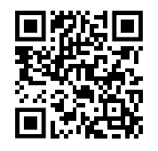
University of Guelph-Humber
Access support as students and alumni:
Career Planning and Job Search Strategies
Resume and Cover Letter Critiques
Interview Preparation and Practice
Post-graduate Resources and Tips
Networking Events and Workshops
guelphhumber.ca/career/contact
career@guelphhumber.ca
Scan to book an appointment with your Career Services Coordinator

Slide 19

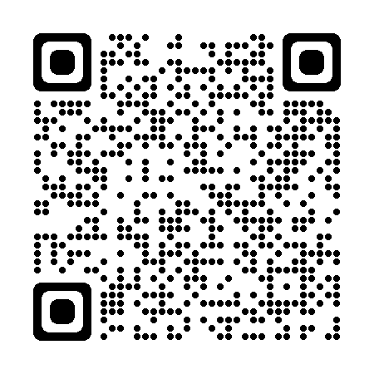
Seneca College
Seneca Works:
https://sw.senecapolytechnic.ca/home.htm
Access:
Career planning and job search resources
Workshops and events calendar
Career Fairs and job postings
Appointment bookings

